Slide 1

Sentiment analysis
Using NLP
A Project By
Aaroh Gaur (22BCS17238)
Rajat (22BCS17134)
Akshay Chambyal (22BCS80293)
Harshit Sharma (22BCS17232)

Slide 2

Content
DATA COLLECTION AND PRE-PROCESSING
01
EXPLORATORY DATA ANALYSIS
02
MODEL SELECTION AND TRAINING
03
EVALUATION OF THE MODELS AND ACCURACY ASSESSMENT
04
VISUALIZATION AND INSIGHTS
05

Slide 3

Data Collection and Pre-Processing
Data Collection:
Platform: Data was collected from Reddit using the PRAW (Python Reddit API Wrapper) library.
Process: Extracted posts and comments related to the project topic, ensuring a diverse data sample.
Criteria: Focused on posts with sufficient interaction (likes, comments) to enhance sentiment analysis reliability.
Preprocessing:
Stop Words Removal: Commonly used words with little semantic value were removed to focus on relevant terms.
Stemming: Reduced words to their root form (e.g., "running" to "run") for consistency.
Lemmatization: Converted words to their base form, considering context (e.g., "better" to "good") to improve sentiment clarity.

Slide 4
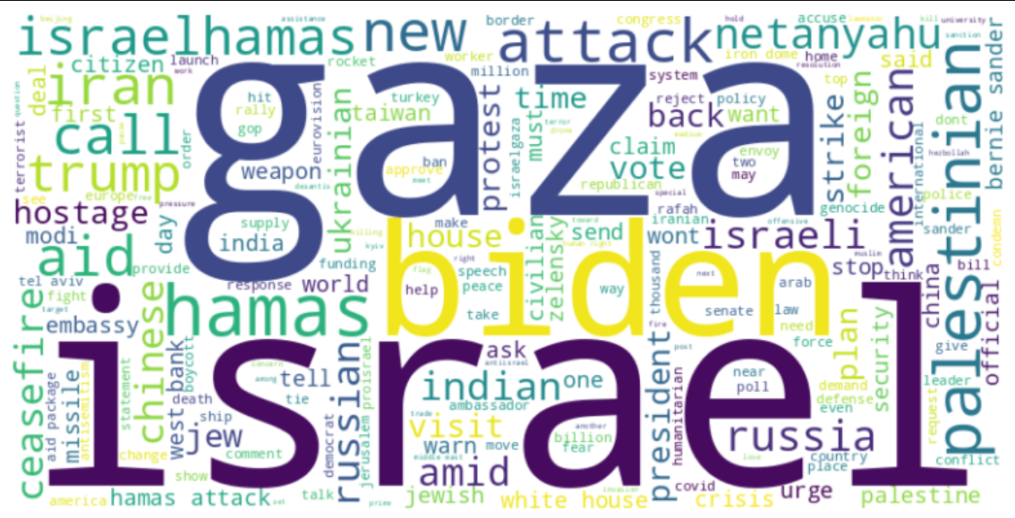
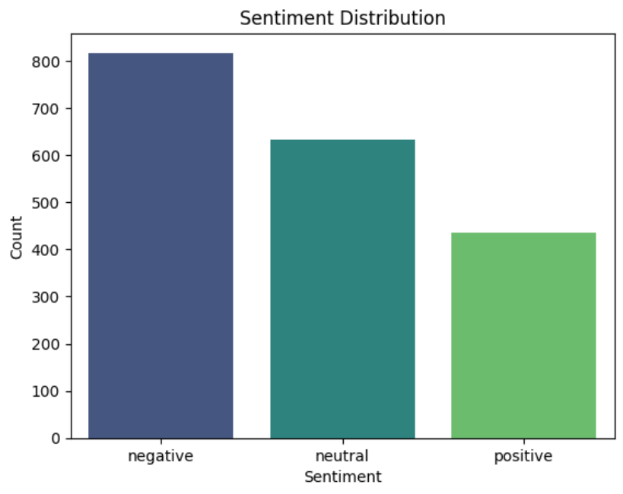
Exploratory Data Analysis
WordCloud - a visual representation of the most frequently used words in a text or set of texts. The words are displayed in different sizes, colors, and orientations to indicate how often they are used. The larger the word, the more common it is in the text.
Bar Plot of Sentiment Distribution - Using the vaderSentiment library we are able to find sentiment of all the reddit posts for our topic and categorize them into negative, positive and neutral.

Slide 5
Model Selection and Training
Logistic Regression:
Selected as a baseline model due to its simplicity and efficiency in binary classification tasks.
Trained on preprocessed data, providing insights into basic sentiment classification.
Naive Bayes:
Utilized for its strong performance on text data, especially with small datasets.
Capitalized on probabilistic techniques to classify sentiments based on word frequency.
Support Vector Machine (SVM):
Leveraged for its ability to maximize class separation and handle high-dimensional data.
Tuned hyperparameters to improve sentiment prediction accuracy on complex patterns.
Random Forest Classifier:
Integrated for its ensemble approach, combining multiple decision trees to enhance classification stability.
Used feature importance scores to analyze the contribution of different words in sentiment classification.

Slide 6
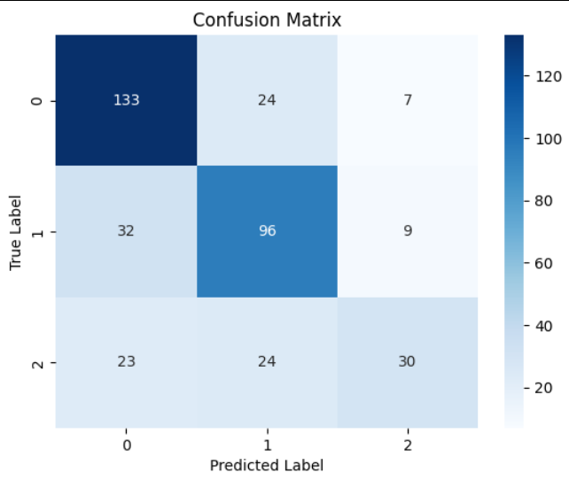
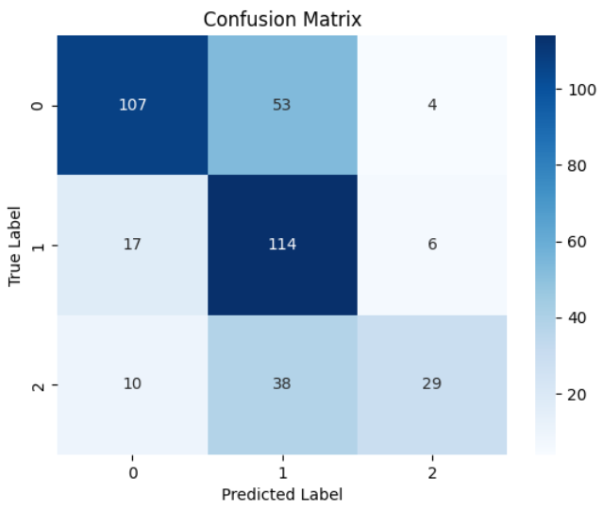
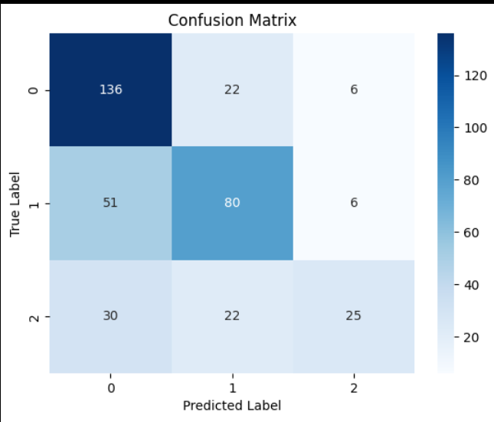
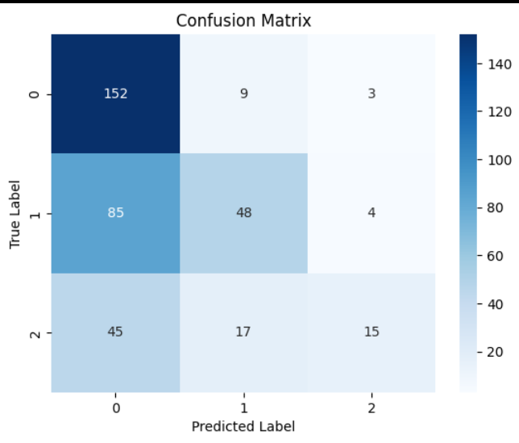
Support Vector Machine (SVM) Confusion Matrix
Random Forest (RF) Confusion Matrix
Logistic Regression (LR) Confusion Matrix
Naive Bayes (NB) Confusion Matrix

Slide 7
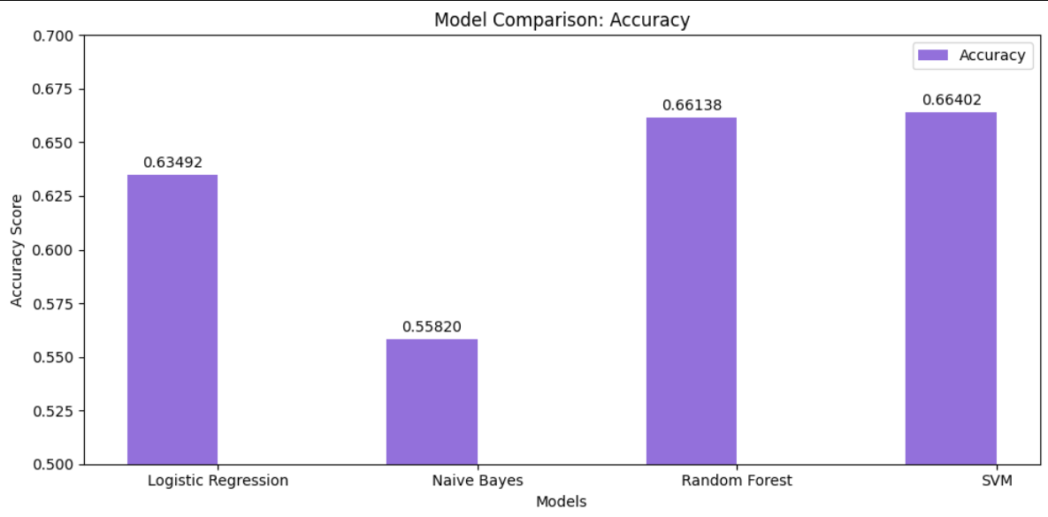
ACCURACY COMPARISON OF THE MODELS ON THE TESTING DATA AFTER TRAINING.

Slide 8
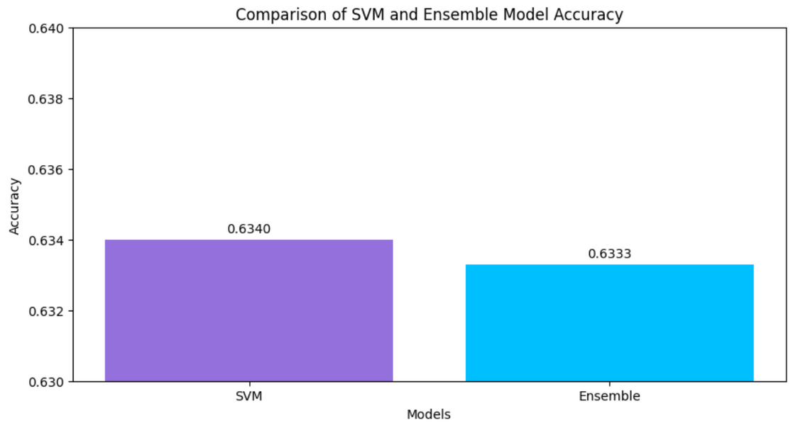
Evaluation of the model
In order to evaluate the accuracy of our model, we went
with K-Fold Validation.
K-Fold Validation :
It averages the results across multiple splits, giving a more robust assessment of how well the model is likely to perform on unseen data.
Now we are making ensemble models to attempt to improve the accuracy of the prediction by combining multiple models.
Average accuracy on 10-fold cross-validation: 0.6340

Slide 9
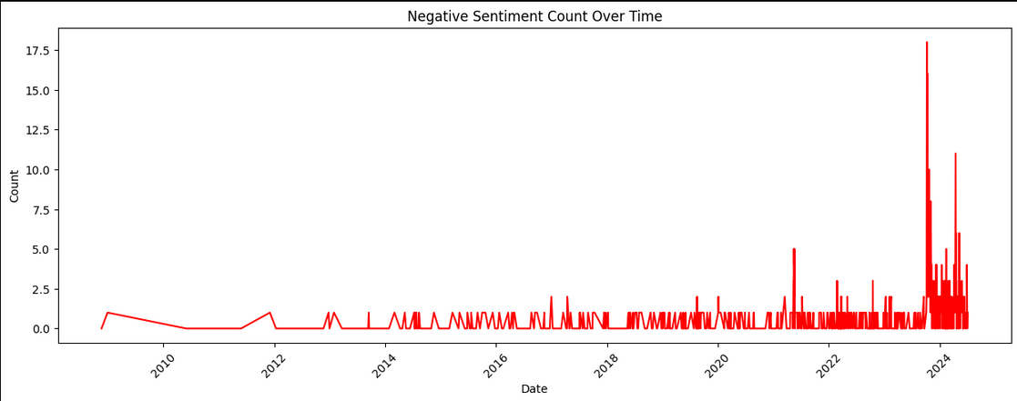
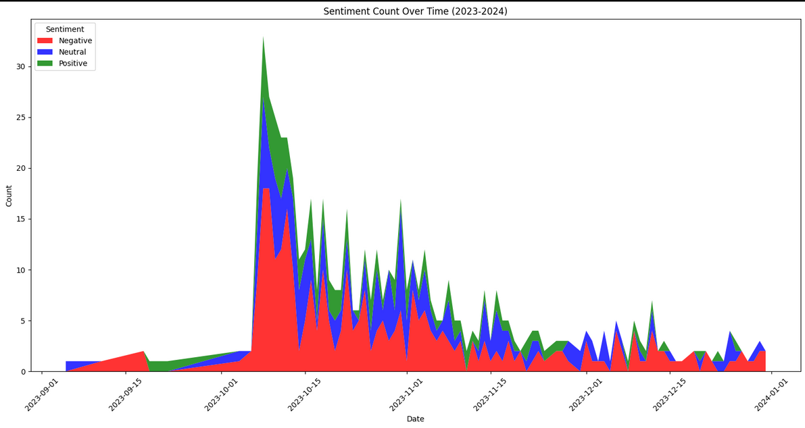
Visualization and insights
Spike Graph for the negative sentiment - We will now plot the graph that will showcase the negative sentiment most encountered) count over time for our research keyword “Israel”
which will help us visualize the sentiment of reddit users on it better.
Trend over Time of Sentiment on Gaza War - We plotted the occurences of the keyword “israel” in relation to the onset of the 2023 Gaza War as an example.

Slide 10
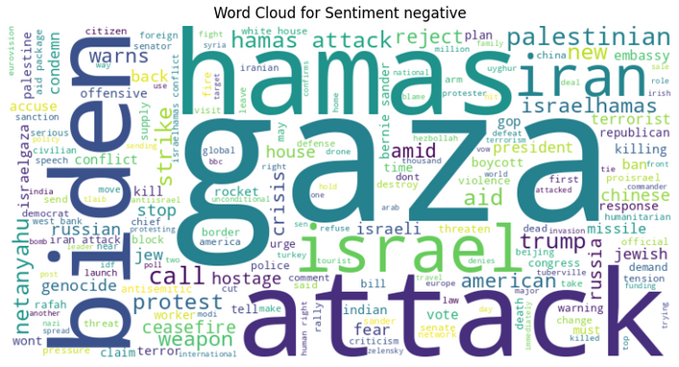
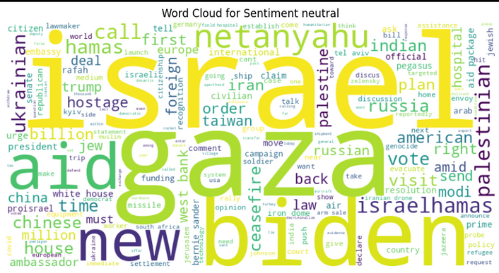
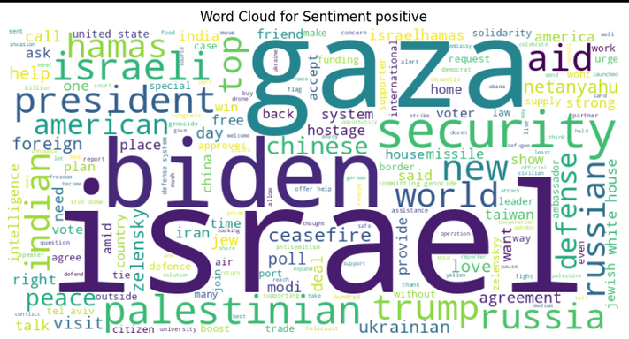
Negative: Words like "attack", "hamas", and "iran" were prominent in the negative word cloud.
Neutral: Words like "Israel", "aid", and "ukrainian" were prominent in the neutral word cloud.
Positive: Words like "security", "president", and "palenstinian" were prominent in the positive word cloud.

Slide 11
Thank You

